Slide 1
agenda overview (wifi: Guest/Stick@@4999)
08:00 AM Welcome
08:45 AM Introduction to Big Data @ AWS
10:00 AM Break
10:15 AM Data Collection and Storage
11:30 AM Break
11:45 AM Real-time Event Processing
01:00 PM Lunch
01:30 PM HPC in the Cloud
02:45 PM Break
03:00 PM Processing & Analytics

Slide 2
AWS big data platform
Rahul Pathak
Sr. Mgr Amazon EMR
Herndon, VA
November 10, 2015

Slide 3
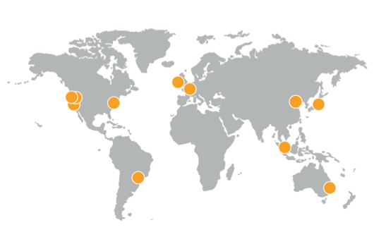
global footprint
Everyday, AWS adds enough new server capacity to support Amazon.com when it was a $7 billion global enterprise.
Over 1 million active customers across 190 countries
800+ government agencies
3,000+ educational institutions
11 regions
28 availability zones
52 edge locations

Slide 4
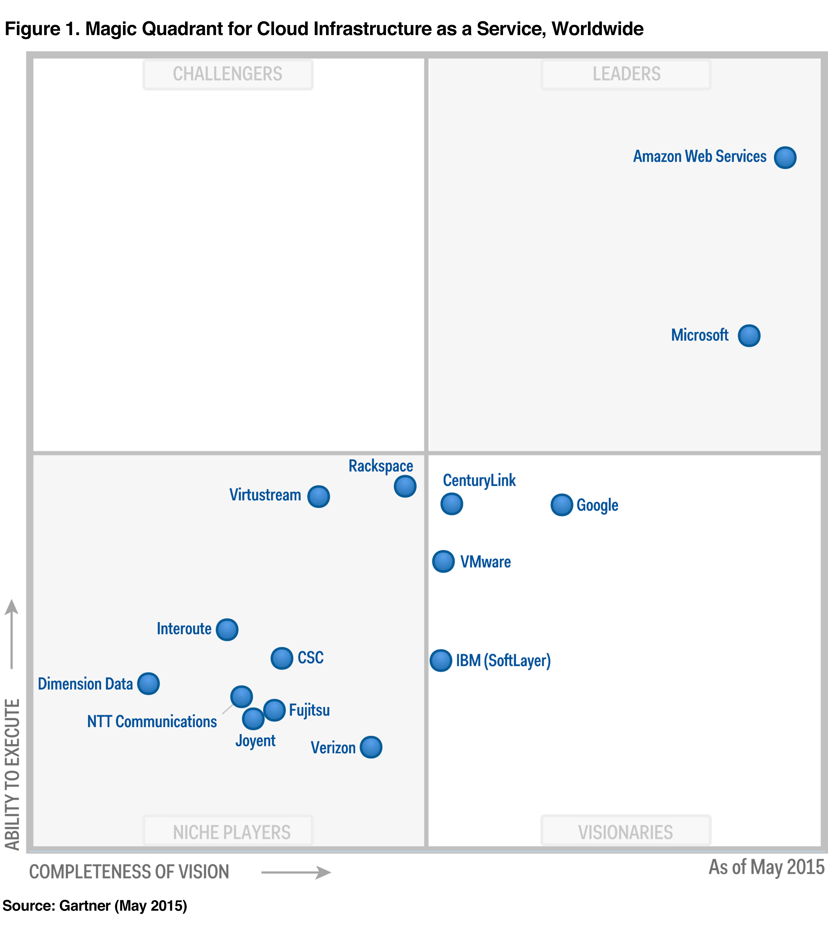
Gartner Magic Quadrant for Cloud Infrastructure as a Service, Worldwide
Gartner “Magic Quadrant for Cloud Infrastructure as a Service, Worldwide,” Lydia Leong, Douglas Toombs, Bob Gill, May 18, 2015. This Magic Quadrant graphic was published by Gartner, Inc. as part of a larger research note and should be evaluated in the context of the entire report. The Gartner report is available at http://aws.amazon.com/resources/analyst-reports/. Gartner does not endorse any vendor, product or service depicted in its research publications, and does not advise technology users to select only those vendors with the highest ratings or other designation. Gartner research publications consist of the opinions of Gartner's research organization and should not be construed as statements of fact. Gartner disclaims all warranties, expressed or implied, with respect to this research, including any warranties of merchantability or fitness for a particular purpose.

Slide 5
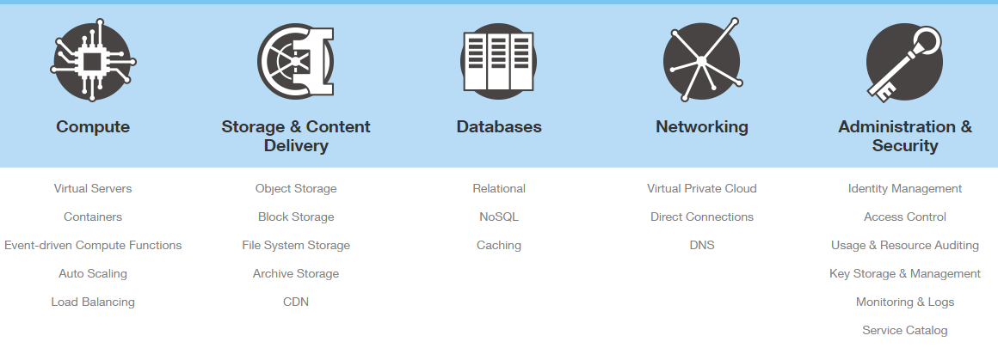
broad & deep core services

Slide 6
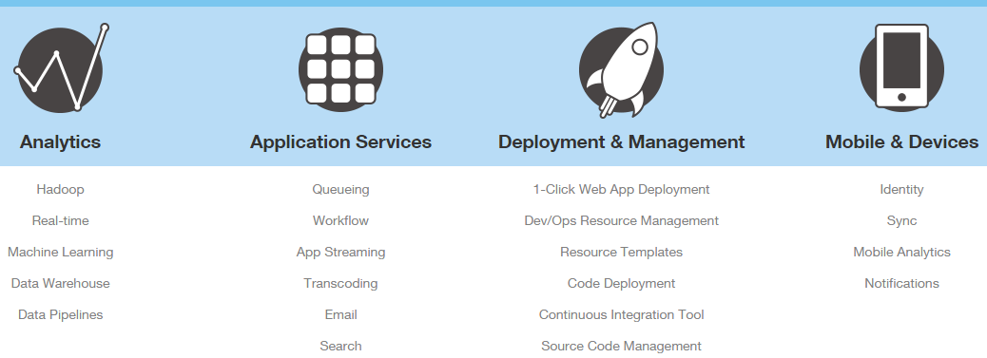
rich platform services

Slide 7




















thousands of big data customers

Slide 8











big data portfolio
Collect
Store
Analyze
AWS Direct Connect
Amazon S3
Amazon RDS, Aurora
Amazon EMR
Amazon EC2
New!
AWS Import/Export
Amazon Glacier
Amazon Dynamo DB
Amazon Redshift
Amazon Machine Learning
Amazon Kinesis Firehose
New!
New!
Amazon Kinesis
Amazon CloudSearch
Amazon ElasticSearch
Amazon QuickSight
New!
Amazon Kinesis Analytics
AWS Database Migration
AWS Data Pipeline

Slide 9
big data pipeline
Collect
Process
Analyze
Data
Answers
Store

Slide 10
primitive patterns
Collect
Process
Analyze
Store
Data Collection
and Storage
Event
Processing
Data
Processing
Data
Analysis

Slide 11
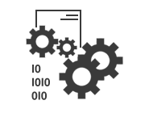

primitive patterns
Collect
Process
Analyze
Store
Data Collection
and Storage
Event
Processing
Data
Processing
Data
Analysis
time data

Slide 12




primitive patterns
Collect
Process
Analyze
Store
Data Collection
and Storage
Event
Processing
Data
Processing
Data
Analysis
S3
Kinesis
DynamoDB
RDS (Aurora)
AWS Lambda
KCL Apps
New!
EMR
Redshift
Amazon QuickSight
Machine
Learning

Slide 13
primitive patterns
Collect
Process
Analyze
Store
Data Collection
and Storage
Event
Processing
Data
Processing
Data
Analysis
S3
Kinesis
DynamoDB
RDS (Aurora)

Slide 14
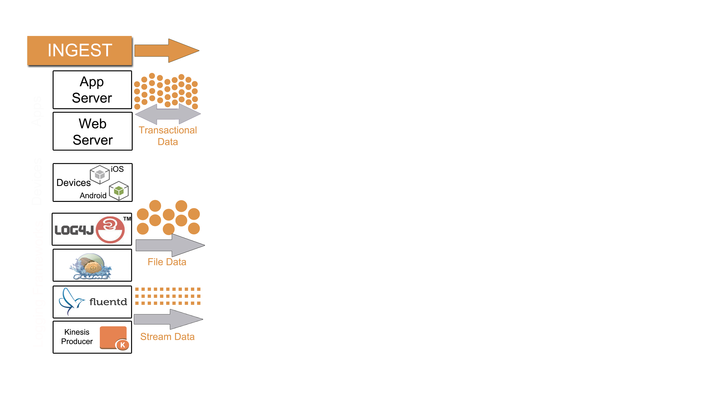
data collection and storage
File: media, log files (sets of records)
Stream: records (eg: device stats)
Transactional: database reads/writes
Apps Devices Logging Frameworks

Slide 15
AWS services – data collection and storage
S3
Kinesis
DynamoDB
RDS (Aurora)

Slide 16
benefits of streamlined data collection
Increase velocity of data
Upgrade existing applications to log records rather than files – driven by need for greater agility
Build new applications that are designed for streaming data from the outset
Example: social media analytics (reference architecture)

Slide 17
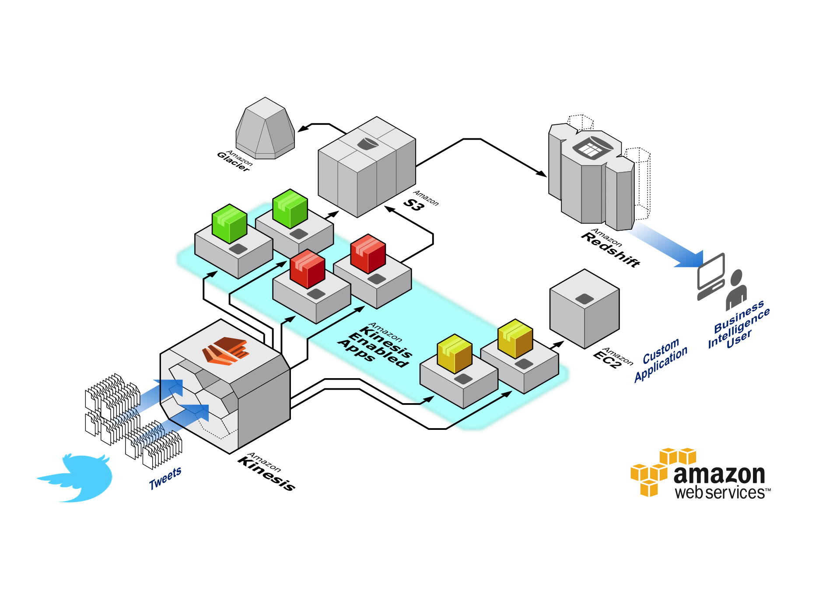
Notes:
500MM tweets/day = 5,800 tweets/second
2.5k/tweet =

Slide 18
Redshift Starts at $0.25/hour
Glacier $0.010/GB-Mo
S3 $0.030/GB-Mo
Kinesis $0.015/shard 1MB/s in; 2MB/out
$0.028/million puts
EC2 Starts at $0.02/hour
Notes:
500MM tweets/day = 5,800 tweets/second
2.5k/tweet =

Slide 19
500MM tweets/day = ~ 5,800 tweets/sec
2k/tweet is ~12MB/sec (~1TB/day)
$0.015/hour per shard, $0.028/million PUTS
Kinesis cost is $0.765/hour
Redshift cost is $0.850/hour (for a 2TB node)
S3 cost is $1.28/hour (no compression)
Total: $2.895/hour
cost & scale

Slide 20




benefits of streamlined data collection
Instrument existing applications
Inject code to log activity – “new big data”
Example: WAPO Labs Social Reader (now Trove)
GET calls & Queries
Query(…
DynamoDB table(s)
Existing
Application
PUT calls
PutItem(…

Slide 21




benefits of streamlined data collection
Increase data granularity
#
Customers Devices Data Items Item Size Frequency
Challenge: compounding scale
Benefit: improved data quality

Slide 22
primitive patterns
Collect
Process
Analyze
Store
Data Collection
and Storage
Event
Processing
Data
Processing
Data
Analysis
AWS Lambda
KCL Apps

Slide 23
event processing – enabling capabilities
S3 Event Notifications
Kinesis stream
DynamoDB Streams
AWS Lambda
KCL Apps

Slide 24
real-time event processing
Event-driven programming
Trigger activities based on real-time input
Examples:
Proactively detect hardware errors in device logs
Identify fraud from activity logs
Monitor performance SLAs
Notify when inventory drops below a threshold

Slide 25
benefits of event processing
Build / add real-time events
Take action between data collection and analytics
Alerts and notifications, performance and security
Automated data enrichment (eg: aggregations)
De-couple application modules
Streamline development and maintenance
Increase agility
MVP + iterate on discrete components
Alert
Collect | Store | Analyze

Slide 26
primitive patterns
Collect
Process
Analyze
Store
Data Collection
and Storage
Event
Processing
Data
Processing
Data
Analysis
EMR
Redshift
Machine
Learning

Slide 27

NASDAQ
Legacy Data Warehouse
Expensive ($1.16M annually)
Limited capacity (1 year of data online)
4-8 billion rows inserted per trading day, storing:
Orders
Trades
Quotes
Market Data
Security Master
Membership
DW can be used to analyze market share, client activity, surveillance, power our billing, and more…

Slide 28
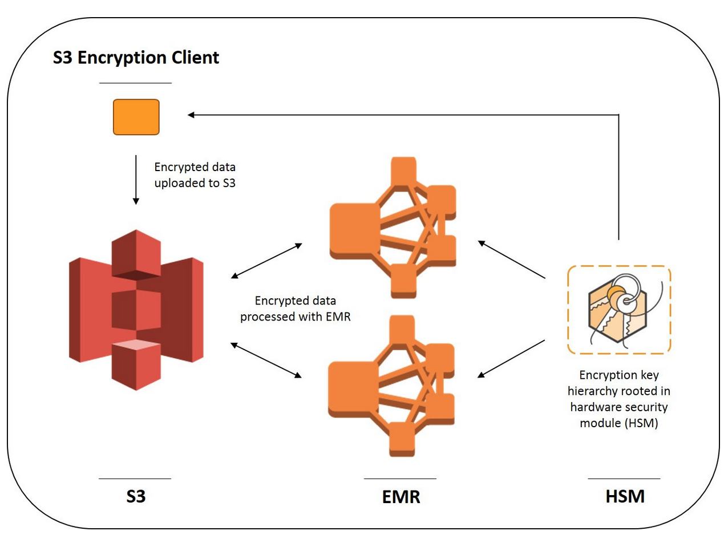
NASDAQ
5.5B Records are loaded to Amazon Redshift every day
Security Requirements for Client Side Encryption
Historical Data - HDFS became too expensive
S3 + EMR to the Rescue
EMR & Redshift

Slide 29
Amazon Redshift has security built-in
Customer VPC
SSL to secure data in transit
Encryption to secure data at rest
AES-256; hardware accelerated
All blocks on disks and in Amazon S3 encrypted
HSM Support
No direct access to compute nodes
Audit logging, AWS CloudTrail, AWS KMS integration
Amazon VPC support
SOC 1/2/3, PCI-DSS Level 1, FedRAMP, HIPAA
SQL Clients/BI Tools
JDBC/ODBC
Internal VPC
Leader Node
128GB RAM
16 cores
16TB disk
10 GigE
(HPC)
Compute Node
Compute Node
Compute Node
128GB RAM
128GB RAM
128GB RAM
16 cores
16 cores
16 cores
16TB disk
16TB disk
16TB disk
Ingestion
Backup
Restore
Amazon S3 / Amazon DynamoDB

Slide 30

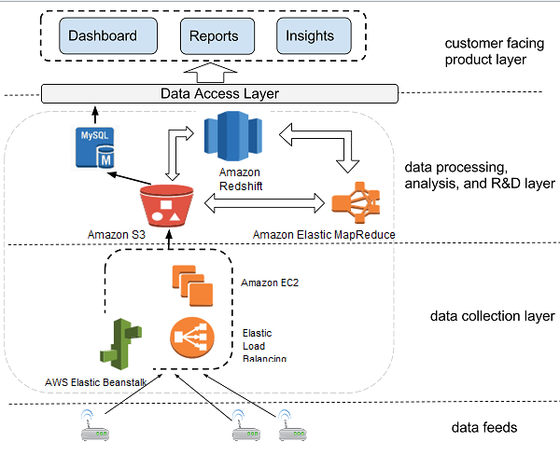
Retail and
POS Analytics
Process 10’s of TB
in hours vs. 2 weeks
80-90% reduction
in costs

Slide 31
big data use cases
Collect
Process
Analyze
Store
Data Collection
and Storage
Event
Processing
Data
Processing
Data
Analysis
Internet of Things
Digital Advertising
Online Gaming
Log Analytics
Customer Value Scoring
Personalization Engine

Slide 32


TempTracker
bee hive monitoring
in the AWS cloud

Slide 33



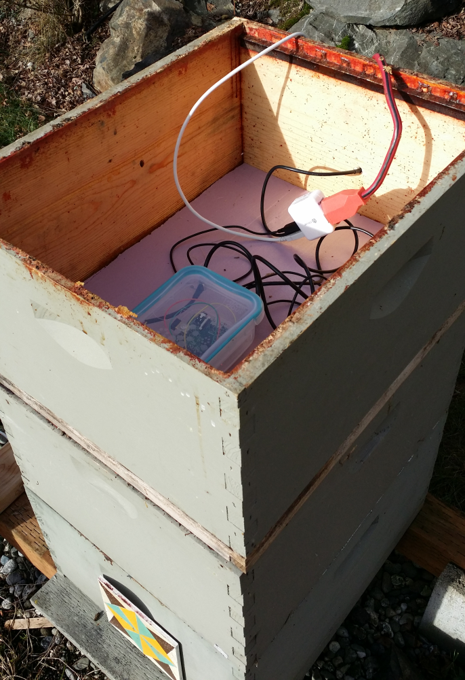
raspberry pi micro server
waterproof housing
temperature sensor board

Slide 34




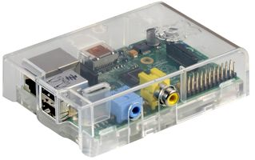



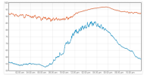
TempTracker: IoT sensor ingestion example
ingestion
Kinesis
Kinesis App
DynamoDB
Python (boto)
event
source
Lambda
SNS
dashboard

Slide 35
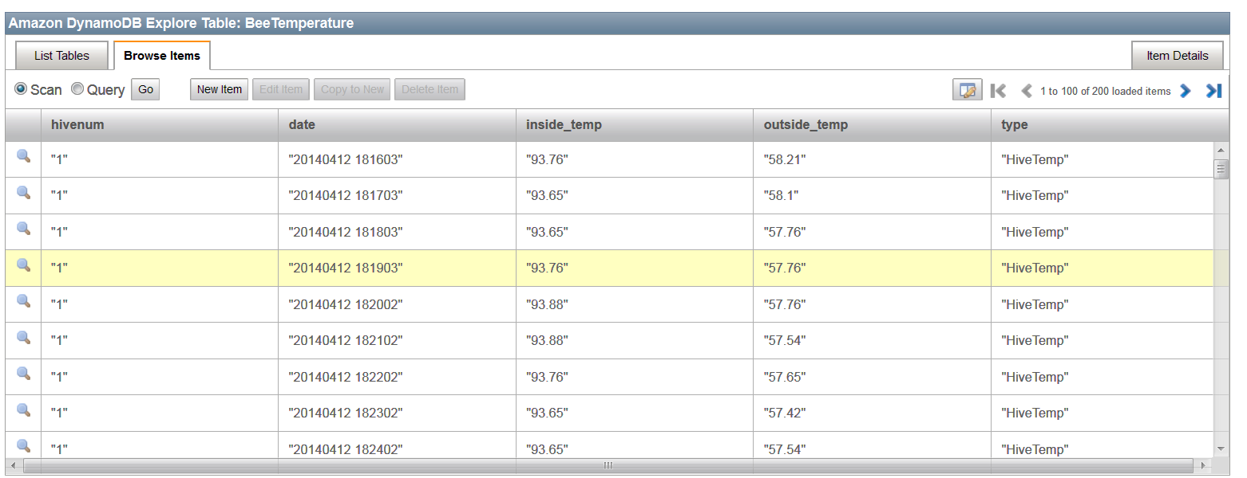
DynamoDB schema
hash range attributes

Slide 36
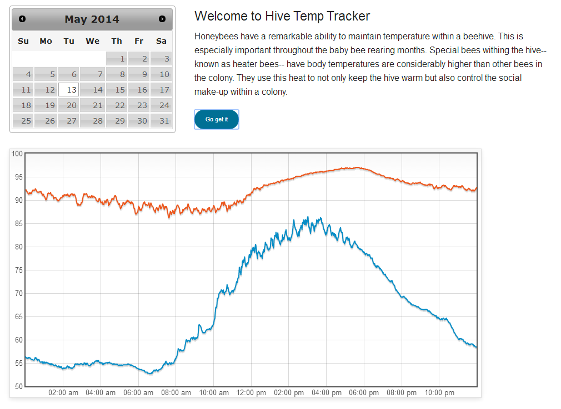
internal temperature
outside temperature

Slide 37

big data case study: Kaiten Sushiro

Slide 38

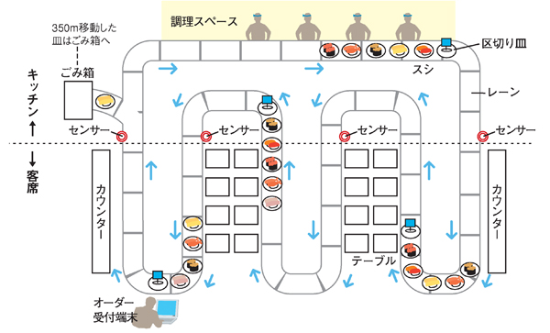

Kaiten Sushiro
Kaiten Sushi Chain restaurant
Gathering sensor data into Kinesis

Slide 39
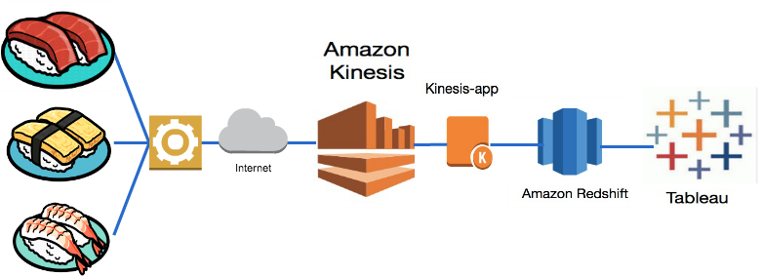
Kaiten Sushiro data flow

Slide 40

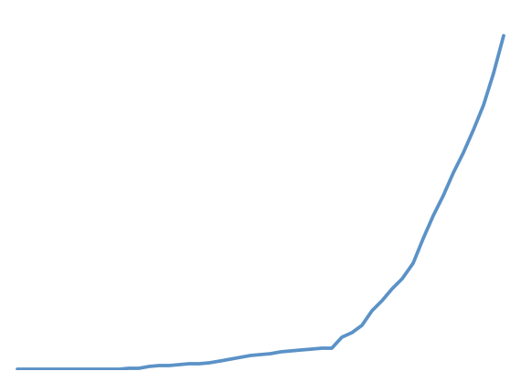
IoT / connected devices
Simple video monitoring & security
Fast growth – “suddenly petabytes”
Switch to
DynamoDB
Move to AWS
cameras
2009
2010
2011
2012
2013

Slide 41
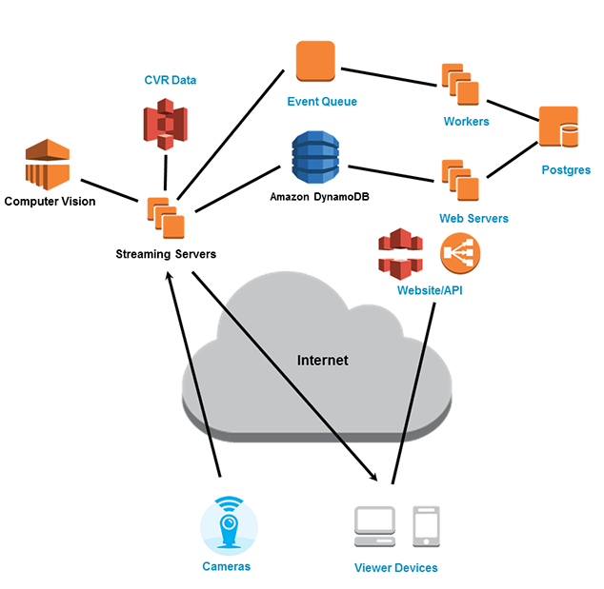
EC2 (live streaming)
S3 (CVR data)
DynamoDB (meta data)
CloudFront (CDN)
EMR (activity recognition)

Slide 42












applying analytics to connected device data
S3
DynamoDB
Lambda
Kinesis
MQTT Broker on
EC2 Instance
Internet Gateway
Data Pipeline
Redshift
VPC Subnet
VPC
SNS
EMR

Slide 43
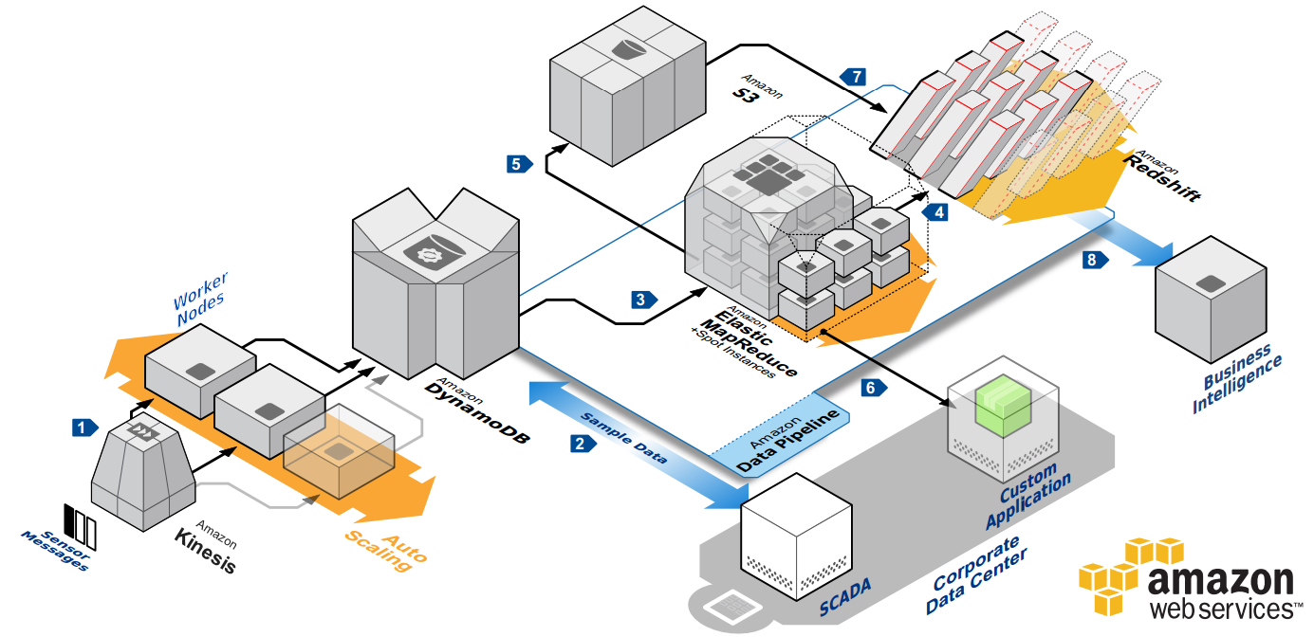
backend analytics architecture for connected device data

Slide 44















AWS big data ecosystem
Collect
Process & Analyze
Visualize
DynamoDB
Data Pipeline
EMR
S3
Redshift
Kinesis

Slide 45





AWS Professional Services Partnering in Your Journey
Technical Specialists
Advisory Services
Proven Process
Collaboration
Specialty practices for AWS skills transfer, security, infrastructure architecture, application optimization, analytics, big data, and operational integration
Portfolio strategy and planning, cost/benefit modeling, governance, change management and risk management as it relates to implementing the AWS platform
Working together with you and APN Premier Partners you already trust to provide you with access to all resources needed to realize breakthrough results
Best practices and patterns to help your teams get the foundation right, deploy and migrate workloads, and create a modern IT operating model to support your business

Slide 46
criteria for big data competency
Minimum requirements to have a solution / service approved
 | Technology (ISV) | Consulting (SI)
APN Membership | Advanced Partner
AWS Support | Business Level
Customer Success | 4+ big data customer references
AWS certifications |  | 4 AWS certified staff
Big Data Practice |  | Public reference to firm's solutions, tools, and guidance on big data
Solution Review | Product approved by AWS Architect Review Board Available in 3+ AWS regions Public support statement

Slide 47





big data partner solutions
Solutions vetted by the AWS Partner Competency Program
Data
Enablement
Move, synchronize, cleanse, and manage data
Data Analysis & Visualization
Turn data into actionable insight and enhance decision making
Infrastructure Intelligence
Harness data generated from your systems and infrastructure
Advanced
Analytics
Anticipate future behaviors and conduct what-if analysis

Slide 48
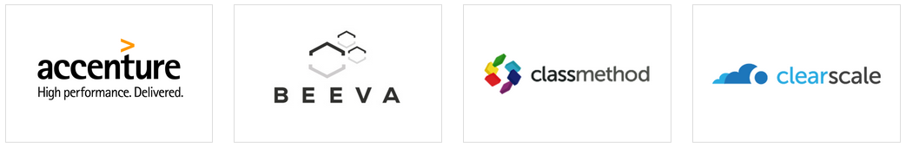



big data service offers
Service expertise vetted by the AWS Partner Competency Program

Slide 49


















AWS marketplace
Enterprise software store for business users who need simplified procurement
2,000+ product listings to browse, test and buy software
Business Intelligence
1-click deployment to launch, in multiple regions around the world
Advanced Analytics
Pay-as-you-go pricing with no long term contracts required
Database and Data Enablement

Slide 50
Amazon QuickSight

Slide 51
A very fast, cloud-powered, business intelligence service for 1/10th the cost of traditional BI software

Slide 52
$9
per user per month
with 1 year commitment

Slide 53

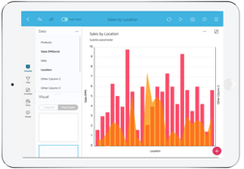
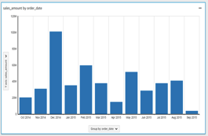









Business User
Business User
Mobile Devices
Web Browsers
QuickSight API
QuickSight UI
Partner BI Products
Connectors
Data Prep
Metadata
SPICE
Suggestions
Files
Amazon Redshift
Amazon RDS
Amazon
S3
Amazon Kinesis
Amazon DynamoDB
Amazon EMR
Third-party

Slide 54
Key Features
Easy exploration of AWS data
Fast insights with SPICE
Super-fast, Parallel, In-memory, Calculation Engine
Intuitive visualizations and transitions with AutoGraph
Native mobile experience
Secure sharing and collaboration using StoryBoard

Slide 55




Easy Exploration of AWS Data
Securely discover and connect to AWS data
Quickly explore AWS data sources
Relational databases
NoSQL databases
Amazon EMR, Amazon S3, files
Streaming data sources
Easily import data from any table or file
Automatic detection of data types
Amazon EMR
Amazon RDS
Amazon Kinesis
Amazon S3
Amazon Dynamo DB
File Upload
Amazon Redshift
Third Party

Slide 56

Fast Insights with SPICE
Super-fast, Parallel, In-memory, Calculation Engine
2 to 4x compression columnar data
Compiled queries with machine code generation
Rich calculations
SQL-like syntax
Very fast response time to queries
Fully managed – No hardware or software to license

Slide 57
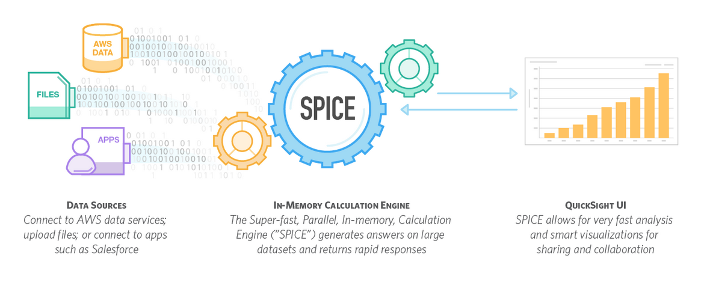

Slide 58
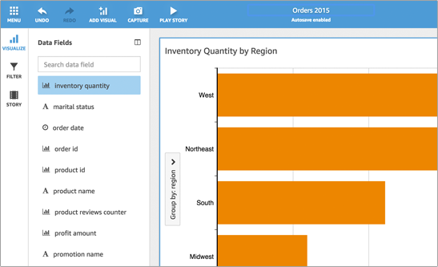
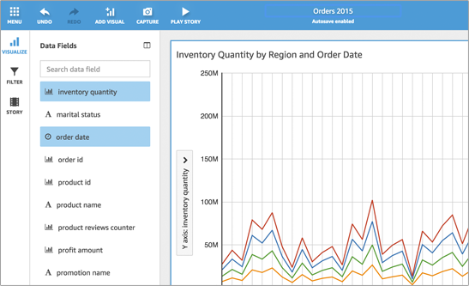
Intuitive Visualizations with AutoGraph
Automatic detection of data types
Optimal query generation
Appropriate graph type selection
Ability to customize the graph type
Very fast response

Slide 59
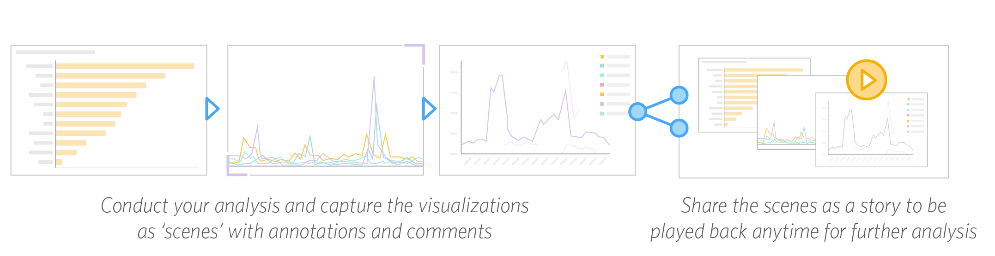
Tell a Story with Your Data
Capture the critical snapshot of analysis
Build a sequence of analysis
Share it securely
Enable interactive exploration
Very fast response

Slide 60

Native mobile experience
iOS, Android
Full experience on tablets
Consumption experience on smart phones
Very fast response

Slide 61
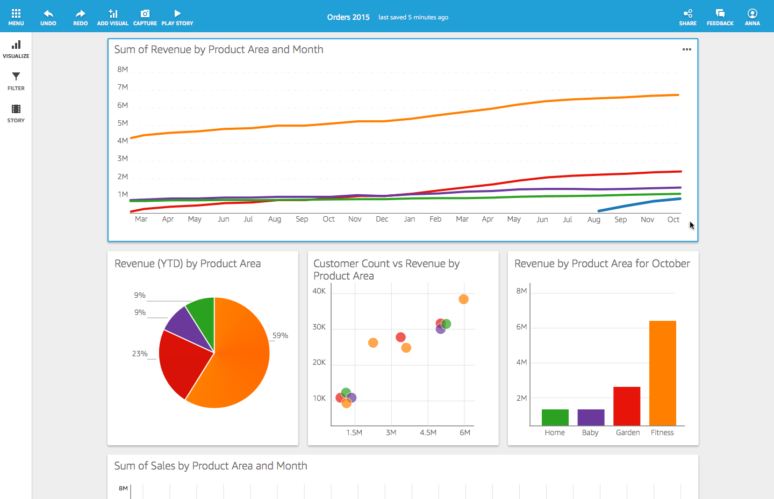
Dashboard
Notes:
DASHBOARDING
Compose multiple visuals from different tables and sources into a dashboard that you can publish and distribute

Slide 62
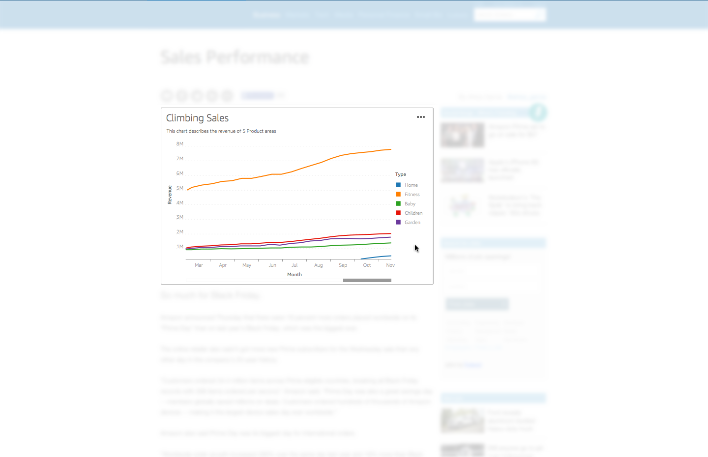
Embeddable

Slide 63
Amazon QuickSight Pricing
 | Standard Edition |  | Enterprise Edition
Subscription | Annual | Monthly | Annual | Monthly
Price per user per month | $9 | $12 | $18 | $24
SPICE Capacity (GB)* | 10 | 10 | 10 | 10
Additional SPICE GB-month | $0.25 |  | $0.38
* Per user SPICE capacity is pooled across all users in an account. As an example, a customer with 100 user subscriptions will get 1,000 GB of SPICE capacity for the account.

Slide 64
How Do I Get Started Using Amazon QuickSight?

Slide 65
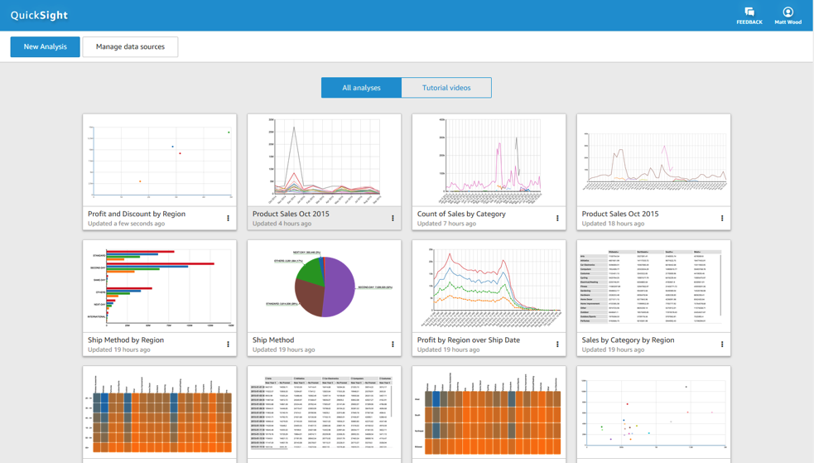

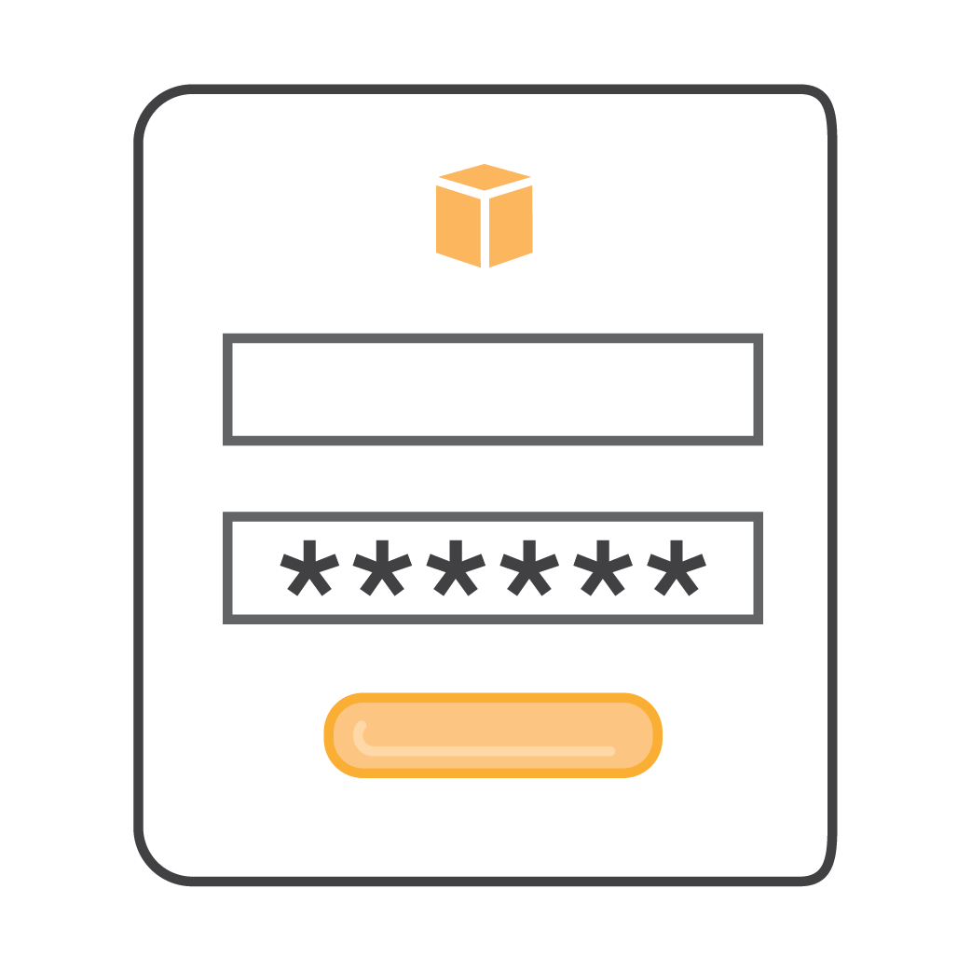
Register for the Preview @ aws.amazon.com/quicksight
Sign-in
First analysis in about 60 seconds
Notes:
Imagery on

Slide 66
Thank you Questions?

